Slide 1
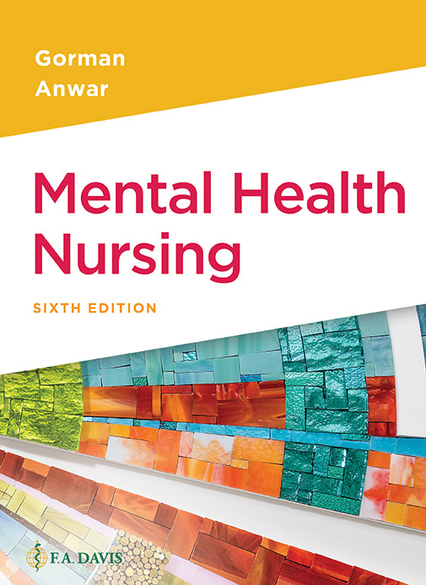
Book cover for Mental Health Nursing, Sixth Edition.
Chapter 18
Eating Disorders

Slide 2
Learning Outcomes
Define anorexia.
Describe the similarities and differences between anorexia and bulimia.
Define morbid obesity.
Discuss bariatric, or weight-loss, surgery.
Identify populations at risk for eating disorders.

Slide 3
Learning Outcomes (continued)
Identify possible causes of eating disorders.
Describe nursing interventions for patients with eating disorders.

Slide 4
Body Image
American media and societal preferences send strong messages that thinner is better
Dangerous messages for youth, adolescents, and young adults
Women are most at risk, but men are not exempt with so much emphasis on perfect physique
Young girls also especially vulnerable and may begin “dieting” at a young age

Slide 5
Causes of Eating Disorders
Negative self-esteem
Depression
Internal struggles with autonomy, sexuality
Gender differences
Women are built differently than men and have a different percentage of body fat
Genetics
Hypothalamus dysfunction (appetite center)
Improper dopamine levels

Slide 6
Causes of Eating Disorders (continued)
Cultural/ethnic differences may affect tendency toward body build and/or weight issues

Slide 7
Types
Anorexia nervosa
Morbid fear of obesity causing anxiety and obsessive fear of losing control of food intake
Distorted body image of self as fat
May or may not include purging
Self-starvation and refusal to eat despite hunger
Excessive exercise after eating to use up calories

Slide 8
Clicker Question
Which of the following are most common with anorexia nervosa?
Eating large quantities at one sitting in private
Wearing loose clothing to hide weight loss
Trying latest diet with girlfriends despite being normal weight
Snacking excessively in secret
Notes:
Correct Answer: B
Rationale: Anorexics often hide their extreme weight loss from family by wearing large size clothing to hide starvation.

Slide 9
Treatment of Anorexia Nervosa
Acknowledge the disorder
Promote slow weight gain (2–3 pounds per week)
Family support
Psychotherapy
Nutrition counseling
Rewards for weight gain sometimes are helpful as behavioral program
Antidepressants and anti-anxiety medications

Slide 10
Anorexia Complications
Serious medical disorder
Complications include electrolyte imbalances, heart failure, bone loss, hormone disruptions

Slide 11
Types (continued)
Bulimia nervosa
Pattern of bingeing and purging
May eat up to 8,000 calories in 2 hours
Use of laxatives and emetics as part of purging
Many additional symptoms including loss of teeth enamel and hoarseness from chronic vomiting
Pattern of tension build up leading to consuming food and then guilt, disgust after purging

Slide 12
Bulimia Nervosa
More associated with depression
More likely to be obese, normal weight, or fluctuating weight
Poor self-image
More associated with substance abuse
Separate diagnosis of binge eating disorder not associated with purging

Slide 13
Clicker Question (continued_1)
Which of the following women is at highest risk for bulimia nervosa?
Teenager in power struggle with stepmother
Schizophrenic girl who is paranoid about source of her food
20-year-old who has struggled with her weight and gains/loses same weight over and over
40-year-old woman who starts liquid diet program
Notes:
Correct answer: C
Rationale: Chronic weight struggles may indicate poor self esteem, depression, and poor impulse control.

Slide 14
Treatment of Bulimia
Acknowledge the problem
Treat depression
Individual and group psychotherapy

Slide 15
Obesity
Obesity and morbid obesity are not considered eating disorders but the effects often lead to emotional distress
Morbid obesity
Body weight greater than 100 pounds above “ideal” body weight

Slide 16
Contributing Factors to Obesity/Morbid Obesity
Genetic
Brain dysfunction—altered satiety center
Depression
Use of food for comfort after psychological traumas

Slide 17
Morbid Obesity
U.S. Preventative Services Task Force has recommended that health-care providers identify people with BMI greater than 30 and refer them for weight-loss counseling
BMI is body mass index—a calculation of weight divided by the square of one’s height in adults to provide approximation of body fat

Slide 18
Treatment of Morbid Obesity
Nutrition counseling
Emotional support
Group approach helpful for some
New medications, including Contrave, Saxenda, and Qsymia

Slide 19
Bariatric Surgery
Several options, including laparoscopic and open abdominal surgery
Generally candidates must be 100 pounds overweight and have failed traditional weight-loss attempts, although those with comorbidities like diabetes may qualify at lower weights
Most programs employ nurses to counsel and work with the person both preoperatively and postoperatively

Slide 20
Bariatric Surgery (continued)
Mental health issues often accompany this kind of surgery
Some surgeons require mental health testing of some sort preoperatively

Slide 21
Nursing Interventions Eating Disorders
Promote positive self-concept and self-acceptance
Promote healthy coping skills
Address feelings associated with food
Promote education for adequate nutrition
Promote appropriate amount of exercise
Focus on positive reinforcement of progress, not on the amount of weight the person is gaining or losing

Slide 22
Clicker Question (continued_2)
Which is the best approach for your patient with an eating disorder during meal times?
Expect patient to eat everything as prescribed
Recognize that meal times are associated with anxiety so give extra support
Give patient privacy at meal time
Remind patient of weight gain/loss goals
Notes:
Correct Answer: B
Meal times are often very stressful for patients with eating disorders so extra support and reassurance are important.

